Slide 1
VET Pathways at Indooroopilly State High School
2020
Subhead goes here

Slide 2
VET – Vocational Education & Training
VET refers to specific training with nationally recognised qualifications:
Certificate I – IV
Diploma
Advanced Diploma

Slide 3
ISHS VET Courses
In the 2024 timetable we offer:
Design and Technologies
Cert I in Manufacturing – Year 10 only
Cert I/II in Construction – Year 11&12
Cert II in Furniture Making Pathways – Year 11&12
Cert II in Engineering Pathways – Year 11&12
Cert II in Hospitality – Year 10 or 11 or 12
Cert II/III in Health Services Assistance - Year 11 and/or 12
The Arts
Cert II in Visual Art – Year 11 & 12
Cert III Screen & Media (Film & TV) – Year 11 & 12

Slide 4
ISHS VET Courses continued
HPE
Cert III in Fitness (Personal Trainer) – Year 11&12
Cert II Sport and Recreation – Year 11&12
Science
Cert II in Sampling and Measurement – Year 11
Business
Diploma of Business
Cert III Aviation (Remote Pilots Licence) – Year 10 only
Languages
Certificate II in AUSLAN – Year 11 & 12

Slide 5
VET & ATAR
Only certain qualifications (Cert III, Cert IV and Diploma) can be counted towards your ATAR.
This will be calculated in conjunction with your school subjects.

Slide 6
VET in Schools (VETiS) Funding
VETiS funding can be accessed while a year 11, 11 or 12 student is enrolled at school and studying a VET qualification OR completing a school-based apprenticeship or traineeship
Students undertaking VETiS, are only funded for 1 VETiS qualification at the certificate I or II level funded under the VET investment budget.
Exceptions to this are:
Courses delivered by the ISHS RTO do not require VETiS funding
- Students can access funding for both a Cert 1 or Cert II using VETiS and through a school-based apprenticeship or traineeship

Slide 7
School-based Traineeships & Apprenticeships

Slide 8
Traineeships & Apprenticeships
School-based traineeships and apprenticeships offer many benefits such as
earning a wage,
work experience,
nationally recognised qualifications, and
credit towards your QCE points
Start a valuable step towards a rewarding career
Common traineeships qualifications include
Cert III in Retail
Cert III in Hospitality
Cert III in Business
Australian and New Zealand residence only (subsidised by the Government)

Slide 9
Traineeships & Apprenticeships
What is the difference between a Traineeship and an Apprenticeship?
Traineeships take 1-2 years to complete and are non-trade based, apprenticeships require a minimum of 3 years to complete and are trade based.
Both apprenticeships and traineeships involves work with an employer who provide an opportunity to learn all aspects of a practical qualification. This is a structured program with a combination of on the job and off the job training at a registered training organisation.

Slide 10
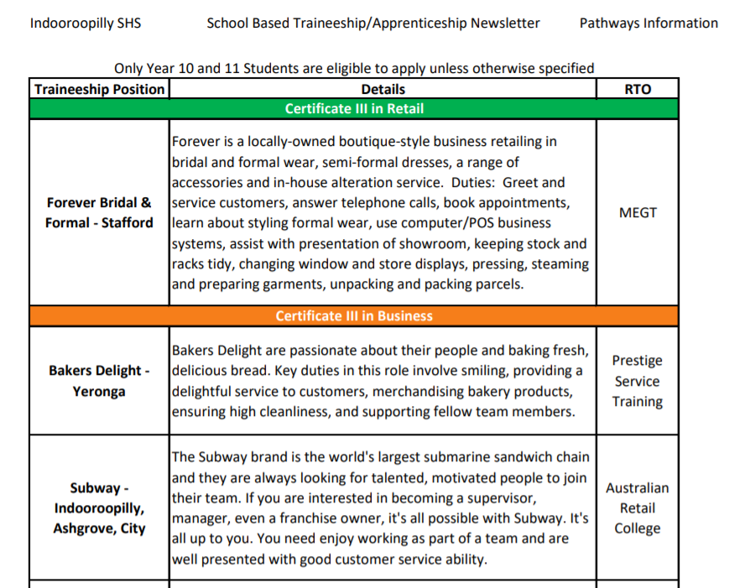
Traineeships & Apprenticeships
Weekly email:

Slide 11
Mr Whitby Head of Year 12
Mr Lassig
HOD – Design & Technologies
RTO Manager

