Slide 1
Welcome to Post school options
for students with disabilities
2020
Subhead goes here
Hillary Morrison
HOD – Integrated Student Support

Slide 2
Statistics -
Do you know?
The average age for a first year apprentice is ….

Slide 3
Statistics -
Do you know?
The average age for a first year apprentice is ….
22 years old

Slide 4
Did you know?
The average age for a first year apprentice is ….
22 years old
Expectations from the employer of an apprentice:
Senior pass in Maths
Has licence (Learners Licence is not enough)
Has maturity
Rigour of most apprenticeships have increased

Slide 5
Who do students listen to when seeking advice about post school options?

Slide 6
Who do students listen to when seeking advice about post school?
Parents
2. Teachers

Slide 7
We all know:
Students should be studying at school for as long as they can for best long term success
Students stay at school to complete Year 12 to receive their QCE or QCIA
2. Post school – university/TAFE/work
Notes:
We can help with all of this

Slide 8
Why are we here tonight?
Life after school can be scary!
The aim of this session is to reassure you and provide information regarding supports available after students finish Year 12, or some hints if you are in Year 9, 10 or 11
Explain post–school options for students with disabilities
Share feedback from a past student
Answer any questions

Slide 9
Post (after) school options
University
TAFE
Work Options (+ work experience)
Support Work Options
Notes:
We will be looking at four options tonight – there is a lot of information and I have placed it all into a handout

Slide 10
University – Supports on Offer
Post school Options | Requirements | Supports on Offer Post School
University (Degree) | ATAR Diploma (option) | Student Services (or similar) phone call or meet in person. Do this as early as possible when university offer is made. Universities are open in January! Case Manager (or similar) will be assigned. Take your school PLP.

Slide 11
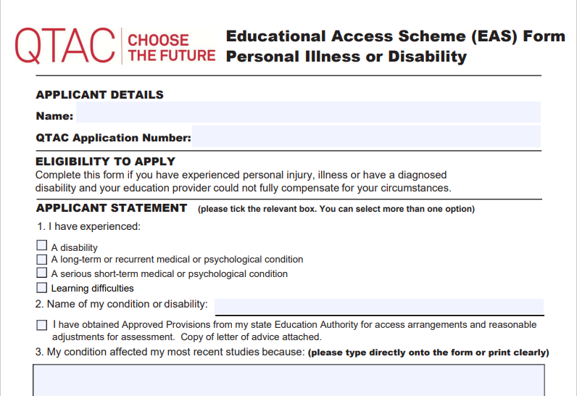
University – Examples of Support
Post school Options | Requirements | Supports on Offer Post School | Examples of Support
University (Degree) | ATAR Diploma (option) | Student Services (or similar) phone call or meet in person. Do this as early as possible when university offer is made. Universities are open in January! Case Manager (or similar) will be assigned. Take your school PLP. | A PLP (or similar ) will be completed with a list of adjustments similar to AARA can be made eg. Extra time/ extensions/use of laptop Educational Access Scheme (EAS form) for ATAR review through QTAC
https://www.qtac.edu.au/educational-access-scheme/

Slide 12
TAFE - Supports on Offer
school Options | Requirements | Supports on Offer Post school
TAFE (Certificate II or Certificate III) | Usually at least Year 10 English and Maths | Student Services (or similar) phone call or meet in person. Do this as early as possible when offer is made. Case Manager (or similar) will be assigned. Take your school PLP.

Slide 13
TAFE - Examples of Support
School Options | Requirements | Supports on Offer Post school | Examples of Support
TAFE (Certificate II or Certificate III) | Usually at least Year 10 English and Maths | Student Services (or similar) phone call or meet in person. Do this as early as possible when offer is made. Case Manager (or similar) will be assigned. Take your school PLP. | Adjustments similar to AARA can be made eg. Extra time/ extensions/use of laptop Flexible timetables NDIS support worker to support access to and from TAFE

Slide 14
Work Option - Supports on Offer
Post school Options | Supports on offer post school
Work options full time - at least 25 hours per week part time – a maximum of 12 hours per week | Disability Employment Services (DES) (eg EPIC, AtWork) Support for employment whilst at school OR after school Usually accessed in Year 12 School can facilitate or families can contact Ongoing support to maintain paid job

Slide 15
Work Option - Examples of Support
Post school Options | Supports on offer post school | Examples of support
Work options full time - at least 25 hours per week part time – a maximum of 12 hours per week | Disability Employment Services (DES) (eg EPIC, AtWork) Support for employment whilst at school OR after school Usually accessed in Year 12 School can facilitate or families can contact Ongoing support to maintain paid job | Provide supported employability skill development eg. Pre-employment support on job - withdrawal of support as increased competency

Slide 16
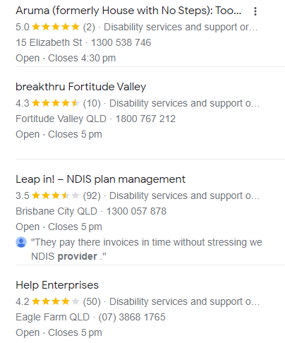
Supported Work Option - SLES
Post school Options | Requirements | When should process begin
Supported work options SLES – Supported Leavers Employment Services eg Jigsaw/Job Support | Nil, but must have NDIS plan | Accessed for Year 12 school leavers and is available for 2 years after leaving school

Slide 17
Supported Work Option - Examples
Post school Options | Requirements | When should process begin | Supports on Offer
Supported work options SLES – Supported Leavers Employment Services eg Jigsaw/Job Support | Nil, but must have NDIS plan | Accessed for Year 12 school leavers and is available for 2 years after leaving school | NDIS plan to identify support Individualised intensive support Access SLES then eligible for DES

Slide 18
Past student feedback
Background:
Diagnosed ASD, ADHD, Anxiety
Currently studying at UQ
When the Uni offer came through:
Booked an appointment with a DDI (diversity, disability inclusion) officer
Sent in forms/supporting evidence/letters from psychologist and psychiatrist
A Student Access Plan (SAP) was created by the DDI officer
The SAP outlines all accommodations required and sent to all course coordinators
Notes:
Link to ISS meanings ie CASE MANAGER/ PLP

Slide 19
Past Student Feedback
Accommodations she receives:
Extra time on exams
Seated in smaller room or back of room so she can fidget/stand/stretch
Allowance to wear ear plugs/noise cancelling headphone during exams
Ability to leave lab pracs if overwhelmed
Request lecturers not to call on her (no forced participation)
Extensions approved without question/without needing medical certificate every time

Slide 20
Past Student Advice
“you work with your DDI officer to come up with accommodations specific to your needs, but the uni is super supportive – it’s just important to get this established immediately”

Slide 21
Upcoming Events
Handout : Wednesday 2nd August – Fresh Futures Markets (CityHall)
Expo for students with additional needs.
Questions?

Slide 22
Questions?

